Slide 1
Pharmacology of Oral Mucositis
Oral Complications in Cancer and Palliative Care
David Houghton BPharm MSc GPhC
Monday 12 May 2014

Slide 2
Definition:
Stomatitis – general term : includes inflammation and ulceration of mucosal lining from any cause
OM – oral mucosal inflammation and ulceration induced by conventional cytotoxic chemotherapy and radiation cancer therapies.

Slide 3
Agents known to cause mucositis
Antibodies | Chemotherapy | Chemotherapy
Alemtuzumab | Docetaxel | Melphalan
Gemtuzumab | Capecitabine | Methotrexate
Trastuzumab | Carboplatin | Mitomycin
Trastuzumab emtansine | Cisplatin | Mitoxantrone
Pertuzumab | Daunorubicin | Oxaliplatin
 | Doxorubicin | Paclitaxel
 | Epirubicin | Pemetrexed
 | Etoposide | Pentostatin
 | Fluorouracil | Thiotepa
 | Idarubicin | Topotecan
 | Irinotecan | Vinblastine
HSCT | Lomustine | Vincristine
Head + Neck RTx |  | Vinorelbine (+oral)
Notes:
Some 40% of patients receiving cytotoxic chemotherapy will develop mucositis during the course of their treatment.
The pharmacological basis of this mucositis is complex, involving sequential interaction of chemotherapy drugs and/or irradiation, on mitosis of proliferating epithelium, release of a number of cytokines, as well as on elements of the oral microbial environment.
Various interventions based on biological attenuation have been tested for mucositis.
Such interventions have been extensively reviewed ; however, most reviews focus on biomedical outcomes.
Little attention has been paid to mucositis outcomes such as oral morbidity or the psychosocial aspects.
The published data suggests that chemotherapy and radiotherapy regimens are the most significant determinants of mucositis. In particular, high-dose methotrexate, etoposide and melphalan, as well as hyperfractionation irradiation will cause most serious forms of mucositis.^{[6,21]}
Studies investigating agents to ameliorate mucosal toxicity should therefore be stratified according to the regimen of cancer therapy.^{[6,22]}
Now we must consider the potential toxicity of “small molecule” tyrosine kinase inhbitors and newer agents
Nevertheless, mucosal response to chemotherapy and radiotherapy tends to be unpredictable.
Dosages that produced severe oral reactions in some patients may cause little or no affect to others receiving the same regimen.
While a large scale multivariate study is lacking, the literature suggests that the collective risk of mucositis in cancer patients relates to several precipitating factors including age, oral hygiene, nutritional status, and xerostomia.

Slide 4
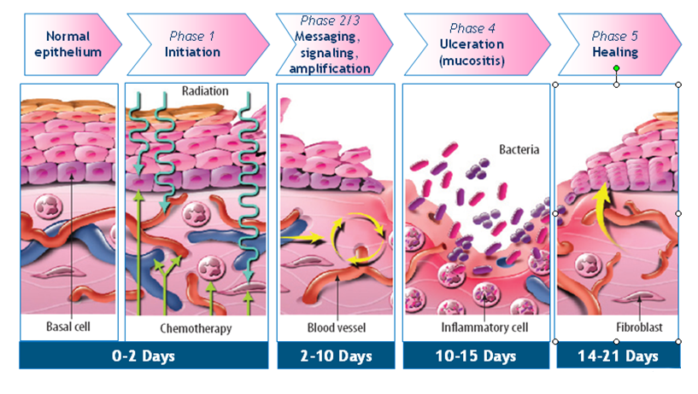
Conventional Pharmacology
The Common Pathway
Adapted from Sonis, ST J Support Oncol 2004;2 (Suppl 3) 3-8
Notes:
5 stages:
Initiation - consists of direct damage to cellular DNA, extensive tissue injury can result in the generation of reaction oxygen species, which can trigger a cascade of inflammatory pathways.
Up-regulation and message generation phase - Activation of a number of signally pathways and transcription factors, most importantly NF-kB. This causes synthesis of TNF IL-6 and IL-1β, adhesion molecules and COX-2 (inflammatory molecules)
Signal amplification by pro-inflammatory cytokines such as TNF – a positive feedback loop which reinforces stage 2
Ulcerative phase – the GI epithelium integrity is destroyed. Bacterial colonization at the site of ulceration further induced inflammation
Healing Phase – spontaneous self resolving process. COX-2 is believed to play a important rebuilding role by initiating angiogenesis.

Slide 5
Conventional Pharmacology High Turnover Rate of Mucosal Cells Makes Them Susceptible to Damage During Cytotoxic Therapy
Normal mucosa provides an effective protective barrier
High epithelial turnover
DNA damage
NonDNA damage
Generation of ROS
Reduced epithelial turnover leads to mucosal breakdown
Reduced turnover
Mucosa becomes susceptible to injury
Mucosal injury
ROS = reactive oxygen species
Adapted from Sonis ST. Nat Rev. 2004;4:277-284.
Notes:
5
High Turnover Rate of Mucosal Cells Makes Them Susceptible to Damage
During Cytotoxic Therapy
The upper layer of the oral mucosa is composed of epithelium. In normal mucosa, the epithelial cells proliferate and constantly renew the epithelium to maintain an effective barrier.
Cytotoxic chemotherapy or radiotherapy damage the epithelium and cells in the underlying tissue.
DNA damage can cause cell death or injury.
Non DNA damage can be mediated by activating injury-producing pathways such as release of proinflammatory cytokines and generation of reactive oxygen species (ROS).
Direct and indirect damage to the epithelial stem cells reduces renewal capacity.
As a result, the epithelium loses integrity and the early symptoms of mucosal damage develop.
Sultani, M., Stringer, A. M., Bowen, J. M., & Gibson, R. J. (2012). Review Article - Anti-inflammatory Cytokines: Important Immunoregulatory Factors Contributing to Chemotherapy-Induced Gastrointestinal Mucositis . Chemotherapy Research and Practice , 1-7.
Reference
Sonis ST. Nat Rev. 2004;4:277-284.

Slide 6
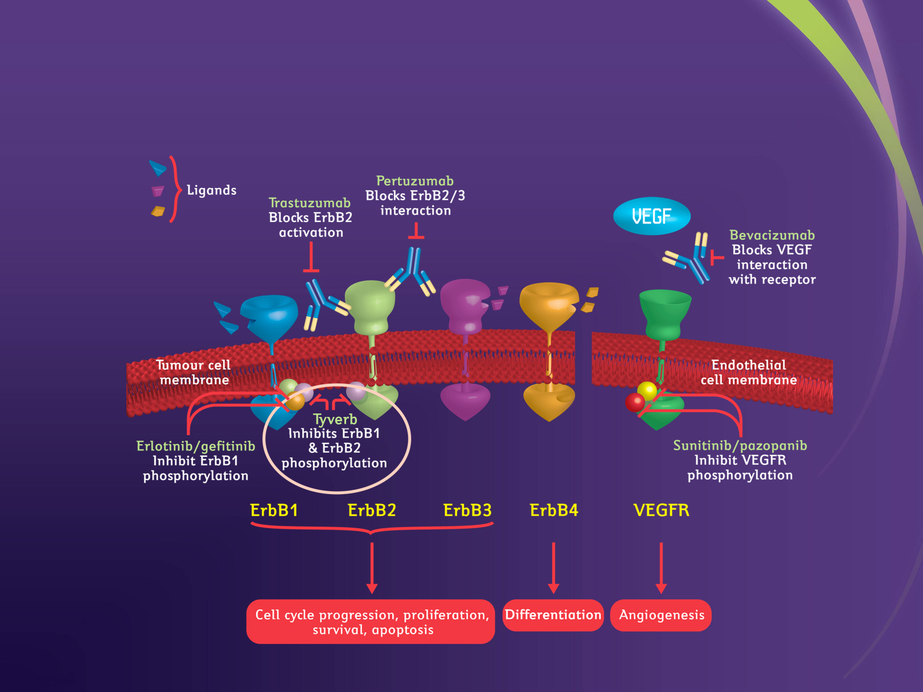
VEGFR
ErbB1=HER1
Notes:
The figure illustrates the sites of activity for some newer targeted agents.
These agents may act on different members of the HER family of receptors, with the exception of HER4.¹
HER1 does not appear to play a major role as a therapeutic target for breast cancer, as far as is currently known, but may be a valid target in other cancers that over express HER1, such as renal, bladder, and head and neck cancers.
Tyverb’s mode of action
Tyverb is a small-molecule, tyrosine kinase inhibitor that targets both the HER1 (EGFR) and HER2 receptors.
It binds reversibly to the ATP- (adenosine triphosphate) binding site of the tyrosine kinase part of the ErbB receptor and thus prevents phosphorylation of the receptor and, consequently, activation of the cell proliferation and survival pathways. Inhibition of these pathways results in growth arrest and/or apoptosis of tumour cells.¹⁻³
By binding intracellularly, Tyverb has been shown to have activity in receptors that have lost their extracellular domains (truncated (p95) ErbB2 receptors).^{4,5}
HER2-targeted monoclonal antibodies, on the other hand, work by binding to the extracellular domain of the receptor and this may explain the lack of activity in truncated HER2 receptors that have lost their extracellular domain.⁶
Rusnak DW, Lackey K, Affleck K et al. The effects of the novel, reversible epidermal growth factor receptor/ErbB-2 tyrosine kinase inhibitor, GW2016, on the growth of human normal and tumor-derived cell lines in vitro and in vivo. Mol Cancer Ther 2001;1:85-94.
Xia W, Mullin RJ, Keith BR et al. Anti-tumor activity of GW572016: a dual tyrosine kinase inhibitor blocks EGF activation of EGFR/erbB2 and downstream Erk1/2 and AKT pathways. Oncogene 2002;21:6255-63.
Nelson HN, Dolder CR. Lapatinib: A novel dual tyrosine kinase inhibitor with activity in solid tumours. Ann Pharmacother 2006;40:261-9.
Moy B, Goss PE. Lapatinib: Current Status and Future Directions in Breast Cancer. Oncologist 2006;11:1047-57.
Xia W, Liu LH, Ho P, Spector NL. Truncated ErbB2 receptor (p95ErbB2) is regulated through heterodimer formation with ErbB3 yet remains sensitive to the dual EGFR/ErbB2 kinase inhibitor GW572016. Oncogene 2004;23:646-53.
Scaltriti M, Rojo F, Ocana A et al. Expression of p95HER2, a truncate form of the HER2 receptor, and response to anti-HER2 therapies in breast cancer. J Natl Cancer Inst 2007;899:628-38.

Slide 7
Conventional Treatment = Symptom Management
Consider preventative interventions (e.g. Caphosol, use of ice chips) ..........? adelmidrol ?
Ensure good oral hygiene – oral care plan, patient education
Saline rinse, moisten, lubricate, cleanse
No alcohol based mouth washes
Dietary restrictions
Local anaesthetic based products
(e.g. Benzydamine, lidocaine)
Systemic analgesia (analgesic ladder)
Protective barrier based mouthwash
(e.g. Sucralfate, Gelclair, MuGard)
Antibiotics, antifungal, antiviral,
(systemic and local)
Intravenous hydration, nutritional support, as needed
THE NEXT STEP.........??
Notes:
For the prevention and treatment of OM most recommendations
begin with an assessment and grading of the mouth using a robust assessment tool
followed by the development of a care plan coupled with patient education.
Ongoing assessment and the use of a range of simple interventions.
Products could be developed
for the prevention and management of OAEs.
These might fall into one or more of
four main categories—
cell resistance modifiers,
mechanism specific inhibitors,
damage control agents,
and healing accelerators.
However, to date, proven approaches for the
prevention of OAEs are somewhat limited.
Adelmidrol is a di-amide derivative of azelaic acid (which together with analogues)
has demonstrated action in the treatment of pain and inflammation on the mucosal and other tissues.
This activity is thought to be mediated , at least in part, by mast cell down regulation.
We know that some of these mediators (chymase, metalloproteinase MMP-9, nitric oxide and TNF-alpha)
are released at the early stages of the inflammatory process

Slide 8
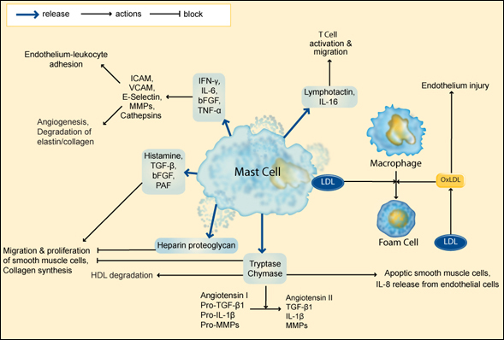
Mast cells can release pro-inflammatory cytokines
Notes:
The vast majority of research data support the notion that multiple mechanisms account for the development and progression of mucositis.
This is not surprising
In 1998, Sonis proposed that mucositis is related to both direct and indirect cytotoxocity, local tissue cytokine and immune activity, and bacterial colonization of ulcerative lesion.^{[19]}
Thus, in theory, we might expect the underlying pharmacology of conventional chemotherapy-induced and radiotherapy-induced mucositis to be similar.
However, differences do exist, related particularly to the systemic effects and the resultant myelosuppression of chemotherapy, in which neutropenia and thrombocytopenia can influence mucositis indirectly through secondary infection and hemorrhage.^{[7,11]}

Slide 9
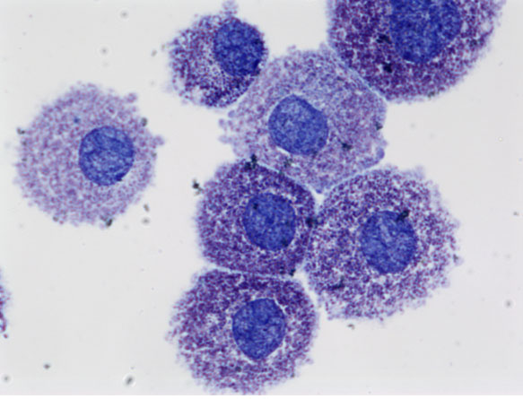
Mast Cells and Oral Inflammation
Mast cells are found in all connective tissue and mucosal environments including oral cavity
They release a range of pre-formed mediators including cytokines, vasoactive amines, and enzymes
Cytokines, such as TNF and Interleukins, cause damage to oral mucosa
Mast cells in the oral mucosa contain stores of histamine and TNF that exceed those in other mast cells.
There is a clear causal relationship between mast cell degranulation, TNF release, and the development of inflammation in the oral mucosa
Walsh, L. J. (2003). Mast Cells and Oral Inflammation . Critical Reviews in Oral Biology & Medicine, 188-198.
Notes:
Two types of mast cells are recognized, those from connective tissue and a distinct set of mucosal mast cells.
The activities of the latter are dependent on T-cells.^{[8]}
Mast cells are present in most tissues characteristically surrounding blood vessels and nerves, and are
especially prominent near tissue boundaries such as the skin, mucosa of the lung and digestive tract,
as well as in the mouth, conjunctiva and nose.^{[2]}

Slide 10
Recently approved targeted therapies associated with Oral Mucositis (any grade)
mTOR Inhibitors EU approval
Everolimus 44% 2009, 2012
Temsirolimus 41% 2007
Tyrosine Kinase Inhibitors
Erlotinib 17% 2005
Sunitinib 38% 2006
Sorafenib 28% 2005
Pazopanib 4% 2009
Source: SmPC and Boers-Doets et al, The Oncologist 2012;17:135-144
Notes:
Targeted anticancer therapy is a general term that refers to
drugs that target pathways in the growth and development of a
tumor cell.
Targeted therapies such as (multitargeted) tyrosine kinase inhibitors (TKIs) and
mammalian target of rapamycin inhibitors (mTORIs) are available for RCC and more recently
Everolimus in combination with the aromatase inhibitor – exemestane - in ER+ve / HER2 –ve breast cancer,
have demonstrate a level of efficacy and improved progression free survival (6.9 months v 2.8 months)
though not without a percentage of patients discontinuing therapy due to SAE’s – particularly OM.
In the case of Afinitor - 56% patients reported stomatitis – any grade v 11% in the exemestane + placebo group
8% with grade 3 stomatitis compared to 1% exemestane alone
Targeted therapies are administered continuously for their long-term ability to inhibit
tumor growth, progression, cell proliferation, and angiogenesis.
Of course in the metastatic disease setting – quality of life is an important consideration.

Slide 11
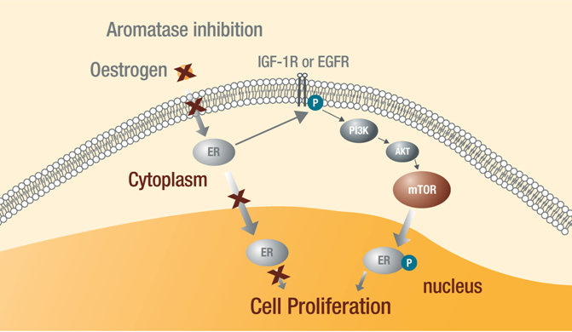
Everolimus plus exemestane: A novel therapeutic strategy
Activation of the mTOR pathway is an important factor driving disease progression and endocrine resistance
Adapted from reference
Vilarreal-Garza C et al. Ann Oncol 2012.23(10):2526-35; 19. Miller TW et al. Breast Cancer Res 2011;13:224-35; 20. Di Cosimo S, Baselga J. Nat Rev Clin Oncol 2010;7:139-47
Notes:
PI3K/AKT/mTOR signaling pathway regulates a number of cellular functions
including metabolism, protein synthesis, cell cycle progression,
angiogenesis, and overall growth and proliferation.
Several human malignancies have demonstrated a constitutive activation of mTOR
or its upstream regulators, leading to enhanced mTOR activity.
Therefore mTOR has emerged as a target for anticancer therapies
with the intent of down-regulating uncontrolled cell growth, proliferation
and survival

Slide 12
mTOR Inhibitors
affect the inflammatory process
involve T-Cell infiltration
Mainly CD8 and cytotoxic T-Cells
results in increased production of pro-inflammatory cytokines
eg. TNF-α, IL-1, IL-2, IL-6
results in decreased epithelial proliferation
Due to lower levels of IL-10
This combination of events leads to the formation of oral ulcers
Martins, F. et al. (2013). A reivew of oral toxicity associated with mTOR inhibitor therapy in cancer patients. Oral Oncology , 1-6.

Slide 13
Tyrosine Kinase Inhibitors
target the capillary endothelium
Blocks VEGFR 1/2/3, PDGFR, c-KIT, FMS like tyrosine kinase 3.
c-KIT is present in the acini and ducts of salivary glands and in human keratinocytes
VEGFR 1 is present in the epidermal layer of unwounded skin
Once damage to the oral mucosa is sustained, would healing is impaired as VEGF regulates the wound repair mechanism
Mignogna, M. D. et al. (2009). Sunitinib Adverse Event: Oral Bullous and Lichenoid Mucositis. The Annals of Pharmacotherapy, 546-547.

Slide 14
Targeted therapies associated with Oral Mucositis (incidence any grade)
Anti VEGF
Bevacizumab ≥ 1:10
Anti HER2
Pertuzumab 27.8% Mucosal inflammation Control arm Docetaxel,+Trastuzumab 19.9% 18.9% Stomatitis
Anti EGFR – wild type
Cetuximab ≥ 1:10 sometimes severe
Panitumumab ≥ 1:10
Source: SmPC (www.medicines.org.uk)
Notes:
Pertuzumab (Perjeta) was licensed in the EU in March 2013
First line metastatic breast cancer in combination with Herceptin and Docetaxel
Pivotal licensing trial - CLEOPATRA

Slide 15
Targeted Therapy Induced Oral Mucositis
Presentation of oral ulcers is different than those seen with conventional chemotherapy
Ulcers mostly affect non-malphighian mucosa of the oral cavity
Consists of painful aphthous ulcerations
Location tends to be zones with local friction and mechanical trauma (e.g. lateral side of tongue, or inner mucosa touching teeth)
Can be recurrent and chronic
Patchy ulcerations which rarely lead to pseudomembranes, confluent ulcerations, bleeding lesions, or tissue necrosis
Inflammatory ring around ulcer
Ferte, C. et al. (2011). Natural history, management and pharmacokinetics of Everolimus-induced-oral ulcers: Insights into compliance issues. European journal of Cancer, 1-7.

Slide 16
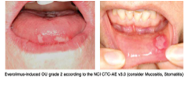
Everolimus
Everolimus induced OM – Grade 2
Ferte, C. et al European Journal of Cancer 47(2011) 2249-2255
Notes:
mTOR inhibitors have recently been approved for metastatic renal cell cancer, mantle cell lymphoma, breast cancer.
These are being investigated for a number of other solid tumours and haematological malignancies and it is expected
Therefore that licensed indications will expand.
Whether administered IV or orally some 40% of patients will experience some form of oral lesion.
Little is known about the pathophysiology, natural history time to event, number of episodes, duration , clinical risk
factors, associated clinical outcome or efficacy of empirical treatment.
In addition, there is no consensus on terminology in
the literature on OAEs associated with targeted therapies,
the terms mucositis and stomatitis are used interchangeably.

Slide 17
Mammalian target of rapamycin inhibitor (mTORI)- temsirolimus Recurrent aphthous stomatitis
Boers-Doets et al, The Oncologist 2012;17:135-144
Notes:
The etiology of recurrent aphthous stomatitis (RAS) is not fully
understood but is believed to be primarily a T-cell mediated inflammatory
condition. RAS typically occurs as an idiopathic condition
affecting upwards of 20% of the population; however, it is also a feature
of several systemic conditions such as inflammatory bowel disease,
AIDS and Behçet syndrome. There appears to be a significant
genetic predisposition as shown by strong associations with genotypes
of IL-1b and IL-6, and a positive family history in about onethird
of patients with RAS.40 It is unclear how mTOR inhibition can
induce oral ulcerations that mimic RAS; however, from a clinical
standpoint, various medical therapies for the management of RAS
are available and may be applicable to oncology patients treated
with mTOR inhibitors. A variety of different agents have been used
for the treatment and prevention of RAS including corticosteroids
(topical and systemic), thalidomide, pentoxifylline and montelukast,
that act by inhibiting inflammatory pathways.

Slide 18
Targeted Therapy Induced Oral Mucositis

Slide 19
Targeted Therapy Induced Oral Mucositis

Slide 20
Bottom Line – paradigm shift
Increasing use of, and increasing indications for, novel targeted therapies with pharmacological action at various points of the cell signal transduction pathway. Will this lead to further anti-inflammatory empirical therapies ?

Slide 21
Bottom Line – paradigm shift
Increasing use of, and increasing indications for, novel targeted therapies with pharmacological action at various points of the cell signal transduction pathway. Will this lead to further anti-inflammatory empirical therapies ?
Prospective RCT’s are needed to evaluate more effective, novel, prevention and treatment strategies.

Slide 22
Bottom line – paradigm shift
Increasing use of, and increasing indications for, novel targeted therapies with pharmacological action at various points of the cell signal transduction pathway. Will this lead to further anti-inflammatory empirical therapies ?
Prospective RCT’s are needed to evaluate more effective, novel, prevention and treatment strategies.
A challenge for all HCP’s to improve the quality of life for their patients whilst maximising benefit of conventional as well as new targeted treatment.

Slide 23
Thank You

Slide 24
And finally.....
A Duck went into a Pharmacy and asked for some lip balm
“Certainly Madam”.. said the Pharmacist
“Will you be paying by cash or card ?”
“Just put it on my Bill” ......said the Duck

Slide 25
References
Ferte, C. et al. (2011). Natural history, management and pharmacokinetics of Everolimus-induced-oral ulcers: Insights into compliance issues. European journal of Cancer, 1-7.
Martins, F. et al. (2013). A reivew of oral toxicity associated with mTOR inhibitor therapy in cancer patients. Oral Oncology , 1-6.
Mignogna, M. D. et al. (2009). Sunitinib Adverse Event: Oral Bullous and Lichenoid Mucositis. The Annals of Pharmacotherapy, 546-547.
Moldawer, N. P., & Wood, L. S. (n.d.). Management of Key Adverse Events Associated with Everolimus Therapy. Kidney Cancer Journal , 51-57.
Peterson, D. E., Keefe, D. M., & Sonis, S. T. (2012). New Frontiers in Mucositis . American Society of Clinical Oncology , 545-550.
Raber-Durlacher, J. E. et al. (2013). Systematic review of cytokines and growth factors for the management of oral mucositis in cancer patients. Support Care in Cancer , 343-355.
Sultani, M., Stringer, A. M., Bowen, J. M., & Gibson, R. J. (2012). Review Article - Anti-inflammatory Cytokines: Important Immunoregulatory Factors Contributing to Chemotherapy-Induced Gastrointestinal Mucositis . Chemotherapy Research and Practice , 1-7.
Walsh, L. J. (2003). Mast Cells and Oral Inflammation . Critical Reviews in Oral Biology & Medicine, 188-198.
Summary of Product Characteristics (www.medicines.org.uk)
De Fillipis, D et al, J Cell Mol Med 2009 Jun;13(6):1086-95
Baselga, J et al, Everolimus in Post Menopausal Hormone Receptor Positive Advanced Breast Cancer. (Bolero 2) N Engl J Med 2012:366;520-9

Slide 26
Afinitor

